Slide 1

Group Members

Slide 2
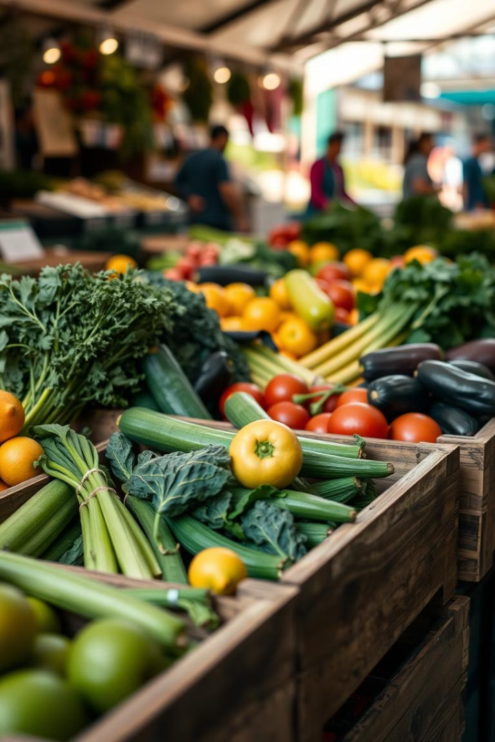
Farm Produce Delivery System
Welcome to our presentation on the Farm Produce Delivery System, a desktop application designed to connect local farmers directly with customers seeking fresh produce. This project addresses the challenge of limited access to fresh fruits and vegetables in many areas and the difficulties farmers face in reaching a broader customer base.
Our system aims to streamline the process of sharing available produce from farmers and enabling customers to subscribe for convenient deliveries. We will explore the system's architecture, key features, and the technologies used in its development.

Slide 3
Project Introduction & Goals
Our project focuses on developing a desktop application in Java to facilitate direct transactions between farmers and customers. The core goal is to enable farmers to list their produce and customers to subscribe for fresh deliveries, bridging the gap in local food supply chains.
The system supports two primary user roles: farmers, who manage produce and deliveries, and customers, who browse, subscribe, and track orders. This report details the system's functionality, user interactions, and development insights.
Farmers
Customers
Add produce listings
Browse produce
View subscriptions
Subscribe for deliveries
Manage deliveries
Track orders

Slide 4
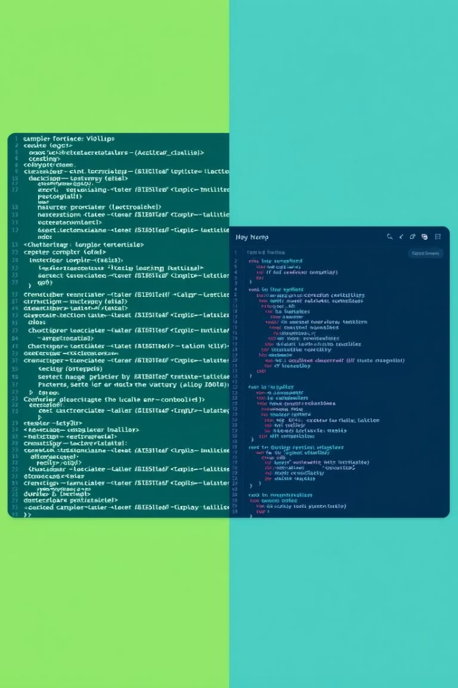


System Architecture
Our Farm Produce Delivery System is composed of two main parts: the Java Logic and the JavaFX GUI. The Java Logic handles all background operations, including data saving, input validation, and managing produce and deliveries. It operates independently of any graphical elements.
The JavaFX GUI provides the user-facing interface with interactive elements like buttons, tables, and menus, ensuring an intuitive user experience. The system is built using object-oriented programming principles, utilizing classes, inheritance, and error handling, with data stored in simple text files for simplicity.
Java Logic
Backend operations, data management, input validation.
JavaFX GUI
User interface, interactive elements, visual display.

Slide 5





Core Features Overview
The system is designed to serve both farmers and customers effectively. Farmers can log in to manage their produce listings, while customers can subscribe to fresh products and oversee their subscriptions. The system also manages delivery planning, tracks harvest dates, and alerts users about invalid actions, such as ordering out-of-season produce.
The project is structured around object-oriented programming principles, with multiple Java classes, and uses plain text files for persistent data storage, ensuring a streamlined and organized approach.
User Management
Product Search
Customer Portal
Login interface and base user attributes for Customer and Farmer.
Enables customers to find and subscribe to available produce.
View produce, manage subscriptions, and receive alerts.
Farmer Dashboard
Delivery System
Add and update produce information, including harvest date validation.
Manages delivery paths and records dispatched produce.

Slide 6
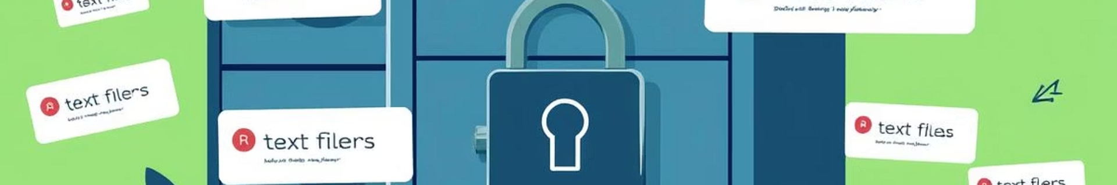
Data Management & Exception Handling
All customer, farmer, and produce data is stored in plain text files within the data/ directory, managed by the FileManager class. This approach simplifies data persistence without requiring a database.
Custom exceptions are implemented to ensure system robustness. These include HarvestDateException for invalid harvest dates, OutOfSeasonException for out-of-season produce subscriptions, and DeliveryUnavailableException for unavailable delivery locations, ensuring correct system behavior under unexpected conditions.
Data Files
Custom Exceptions
customers.txt
HarvestDateException
farmers.txt
OutOfSeasonException
produce_updated.txt
DeliveryUnavailableException

Slide 7
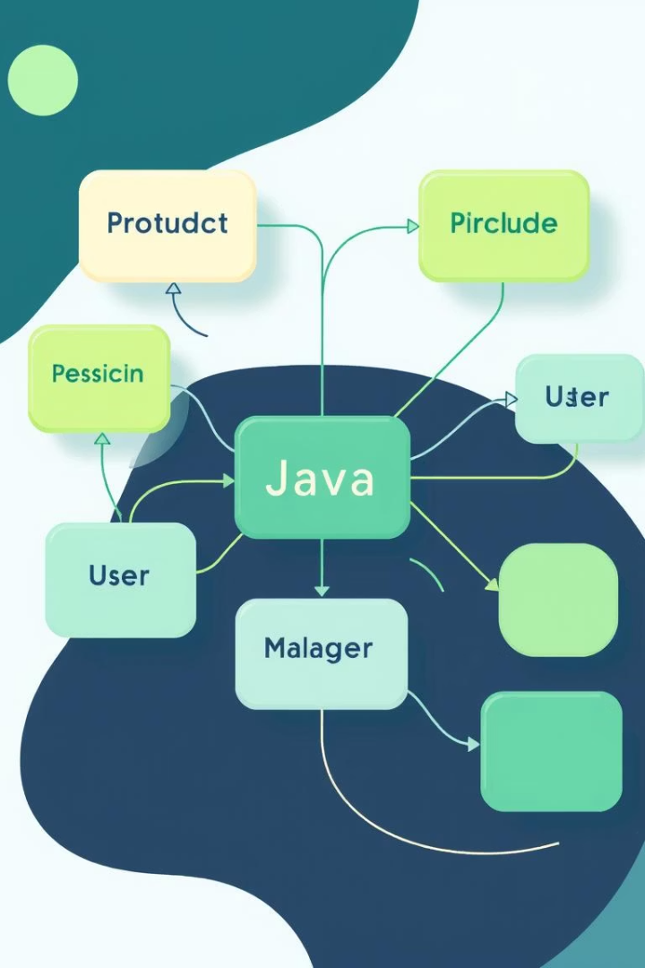




Core Logic Components
Beyond the GUI, the project incorporates substantial backend logic and core functionalities implemented purely in Java. These components are crucial for maintaining system integrity, functionality, and data processing, and can be tested independently of the user interface.
Key classes like Product.java, Customer.java, Farmer.java, and Subscription.java handle produce management, user-specific actions, and subscription logic. Search and delivery functionalities are managed by ProductSearch.java, ProductSearchEngine.java, and DeliverySystem.java, while FileManager.java handles data storage.
Product
Users
Subscription
Manages produce objects.
Customer and Farmer logic.
Manages customer subscriptions.
File Manager
Handles data storage.

Slide 8
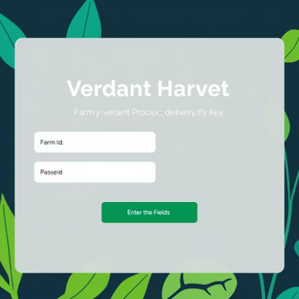
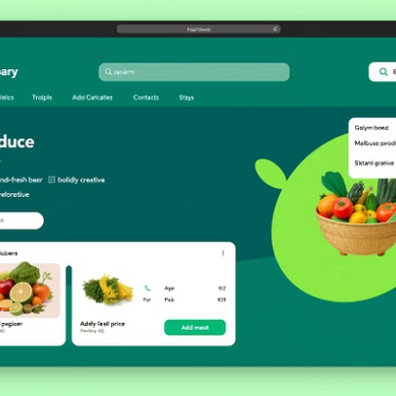
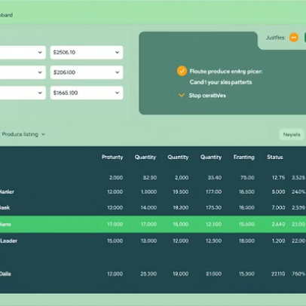
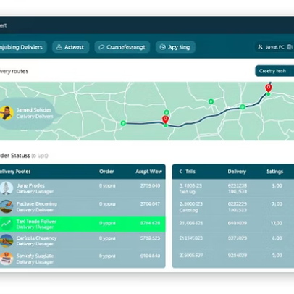
Graphical User Interface (GUI)
The Graphical User Interface (GUI) is built using JavaFX, providing a user-friendly and interactive experience. The application's entry point is MainApp.java, which loads the primary screens.
Styling rules for all UI components are defined in the style.css file, ensuring a consistent and appealing visual design. The GUI allows users to easily navigate and interact with the system using a mouse and keyboard.

Slide 9

Conclusion & Future Enhancements
This project provided our group with valuable practical experience in Java programming, GUI development, and data management. We successfully developed a fully functional Farm Produce Delivery System, ensuring all components, from user login to delivery management, operate seamlessly.
Looking ahead, we aim to enhance the system by migrating to a robust database backend for improved data handling and scalability. Additionally, further GUI enhancements will be considered to provide an even better user experience.
Future: GUI
Future: Database
Enhance GUI for improved user experience.
Functional System
Consider migrating to a database backend.
Practical Experience
Successfully developed a working delivery system.
Gained expertise in Java, GUI, and data management.

